Slide 1
BIPOLAR JUNCTION TRANSISTOR (BJT)

Slide 2
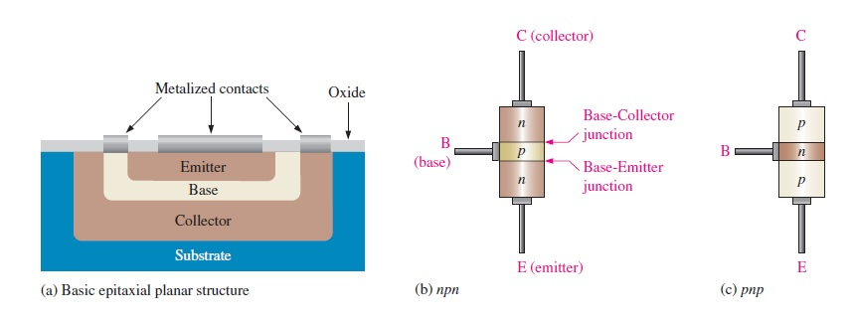
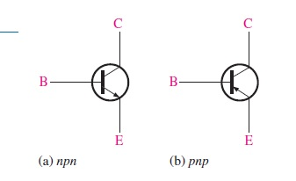
BIPOLAR JUNCTION TRANSISTOR (BJT) STRUCTURE

Slide 3
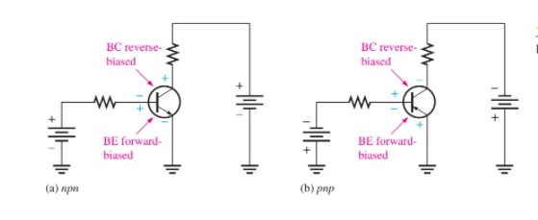
BASIC BJT OPERATION

Slide 4
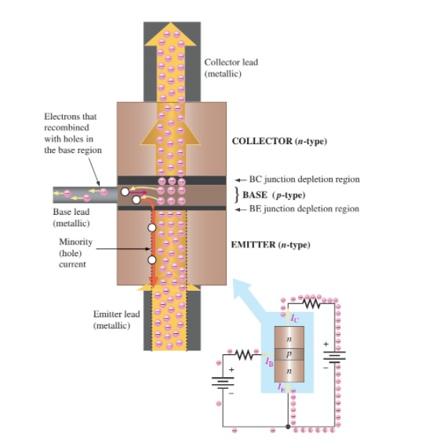

Slide 5
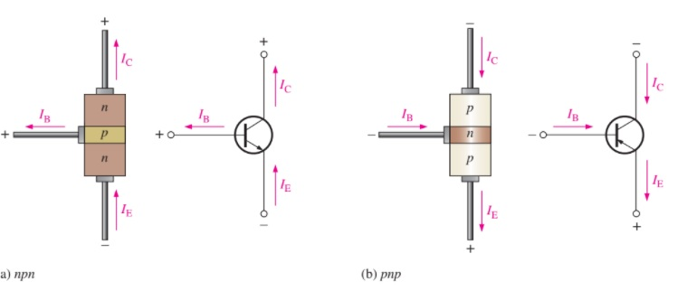
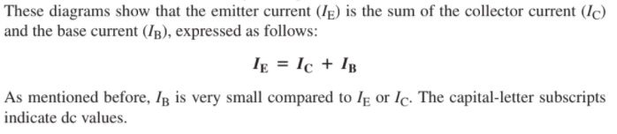
Transistor Currents

Slide 6
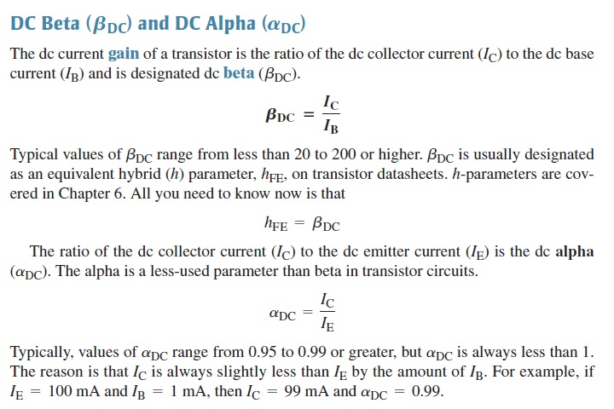
BJT CHARACTERISTICS AND PARAMETERS

Slide 7
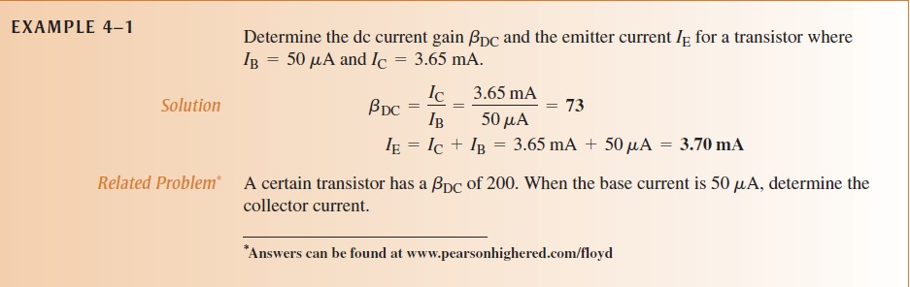

Slide 8
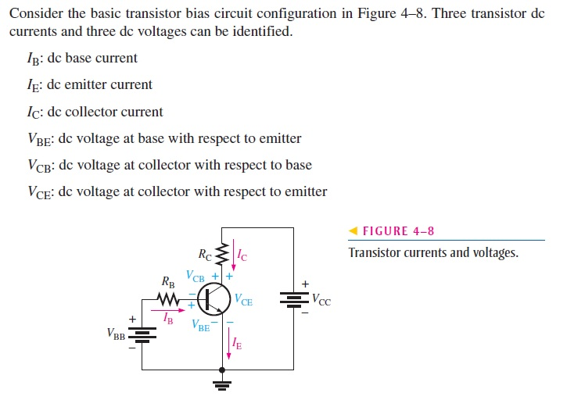
BJT Circuit Analysis

Slide 9
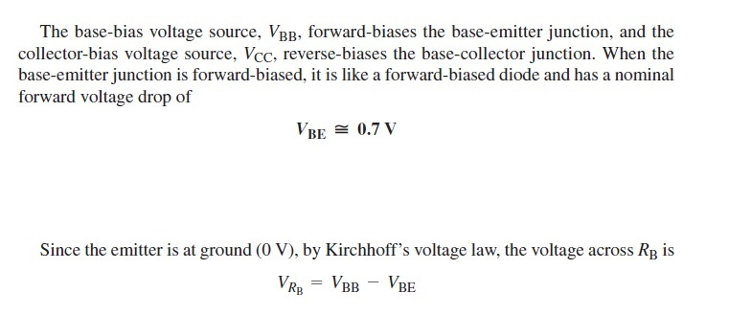

Slide 10
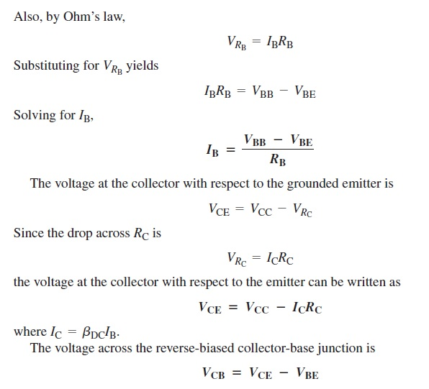

Slide 11
